Slide 1
VOL-1
SEP-2020
KAMAL MODEL SR SECONDARY SCHOOL
COGNIZENCE
गुरुर ब्रह्मा गुरुर विष्णु गुरुर देवो महेश्वरः गुरुः साक्षात्परब्रह्मा तस्मै श्री गुरुवे नमः

Slide 2
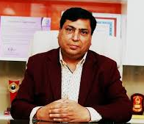
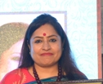
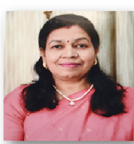
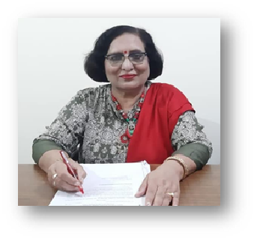
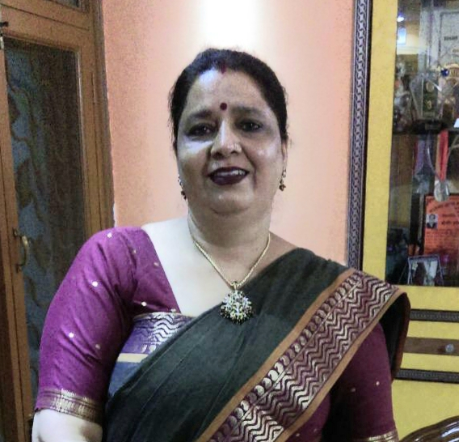
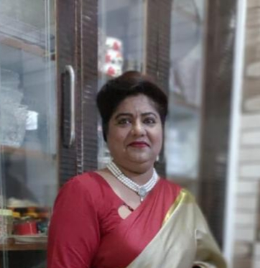
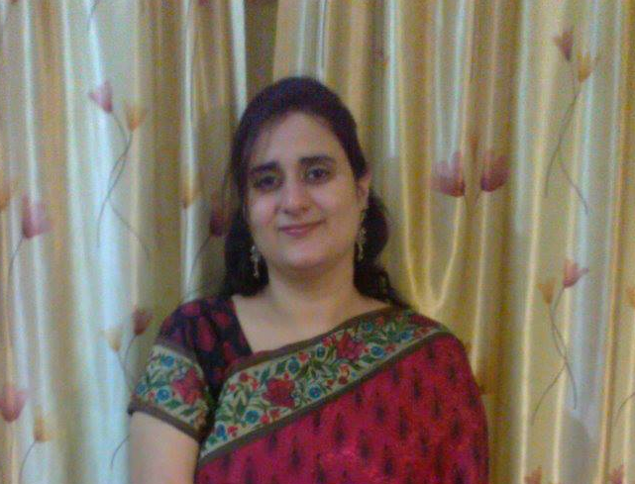
GUIDING PILLARS
Mr V.P Tandon
The Chairman
Ms Vandana Tandon
The Principal
Ms Pramila Mishra
Academic Director
Ms Pushpa Jindal
Academic Coordinator
Ms Shalini Gupta
6th Coordinator
Ms Veena Aggarwal
7th Coordinator
Ms Jasvinder Kaur
8th Coordinator

Slide 3
Virtual Teacher’s Day
A teacher is a friend, philosopher and a guide who holds our hand, opens our mind, and touches our heart. The contribution of a teacher cannot be ignored at all. In keeping with the tradition of celebrating Teachers’ Day this year too Kamal Model Sr Sec School celebrated the great event in a virtual manner. The program began with a speech given by Mrs Vandana Tandon, The Principal of our school. An awe-inspiring dance performance by the students really enthralled the audience. Even a short skit portraying the transforming role of a teacher post covid-19 was also done by the students. Not only this glimpse of the life of teachers were also shown. According to the characteristic traits depicted by a teacher, each of the teacher was bestowed with befitting titles. The most important part of the program was the expression of the student’s love and gratitude towards their teachers through cards, poems and short compositions.

Slide 4
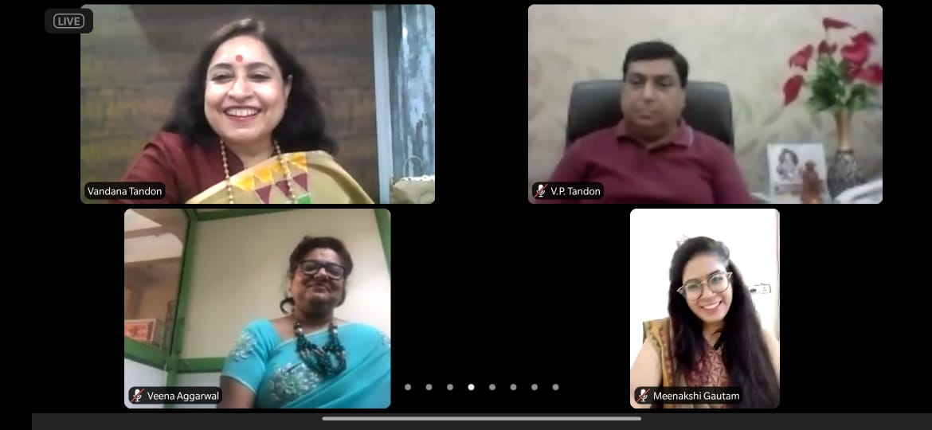
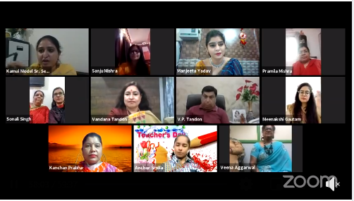
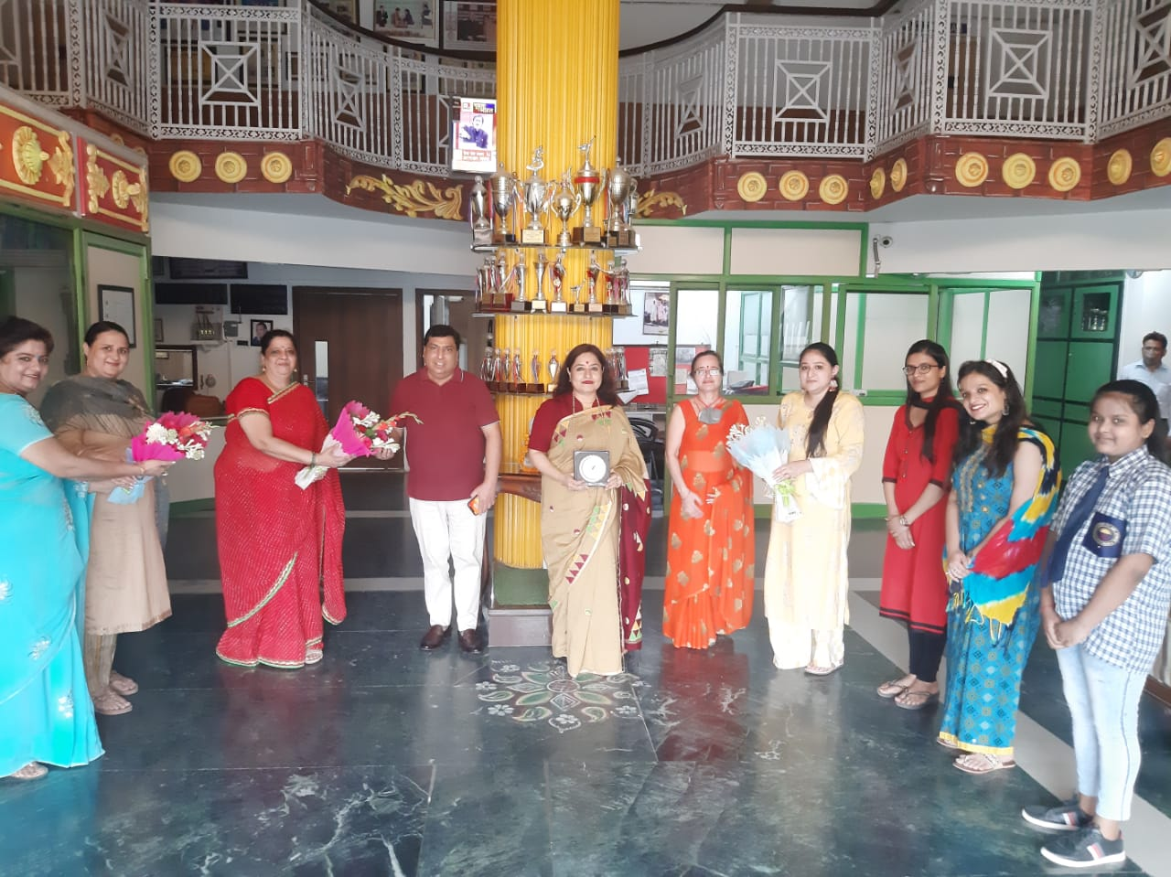

Slide 5
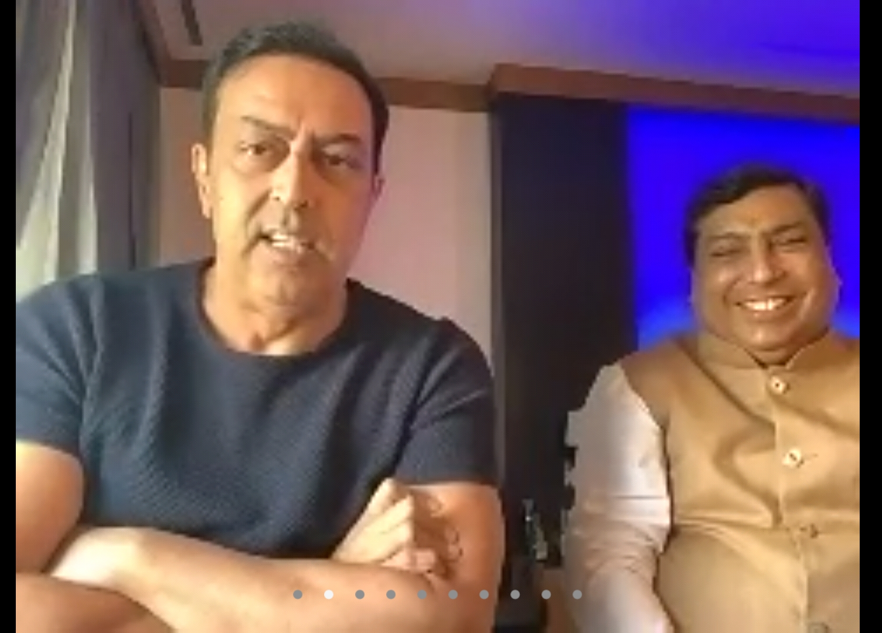
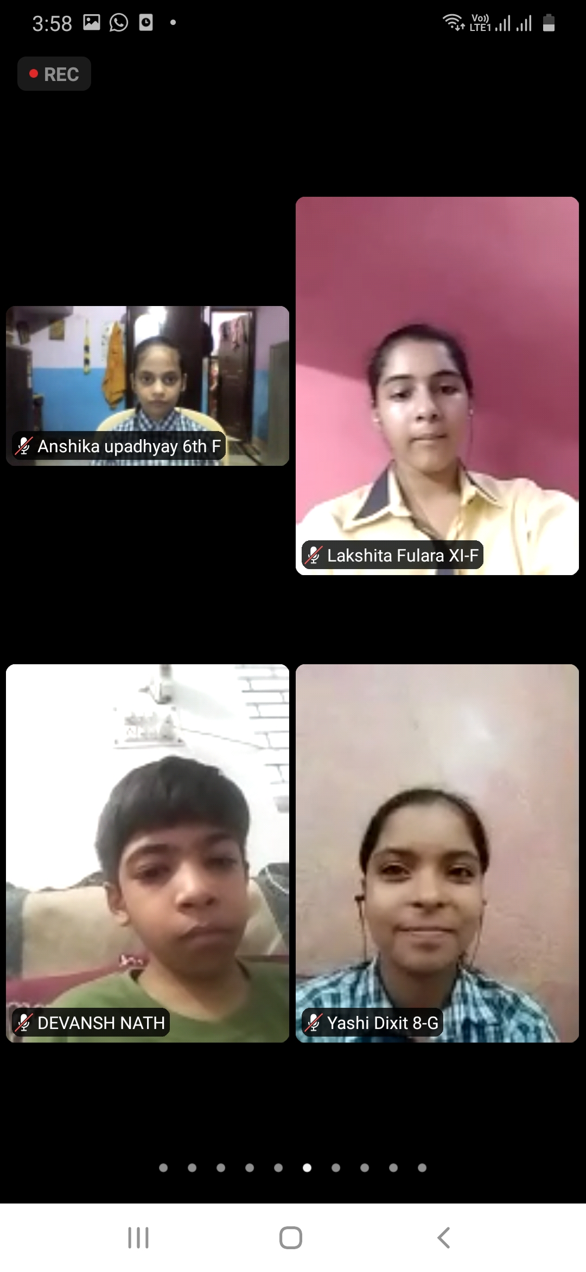
Motivational Session with
Vindu Dara Singh
On 10 September 2020, the young talented budding students of Kamal Model and Vandana International School got the opportunity of interacting with the famous celebrity Sir Vindu Dara Singh- a wrestler turned actor. The program began with the religious performance of Saraswati Vandana followed by a melodious song sung by the students. Our Honourable chairman, Shri V. P. Tandon gave a welcome speech. The whole session was a lively one wherein the queries of students were patiently answered by Sir Vindu Dara Singh. The inspirational and motivational message conveyed by him to the students was that they should follow their heart and instincts, have a clear focused goal and strive hard to achieve it and lastly always remain down-to- earth. The mantra of happiness according to Sir Vindu Dara Singh is that one should always speak the truth. Along with this, Sir Vindu Dara Singh also shared his secret of fitness that is regular exercise and a proper diet regime. The inspiring words of Sir Vindu Dara Singh really seemed to have found their way into the student’s mind and heart.

Slide 6
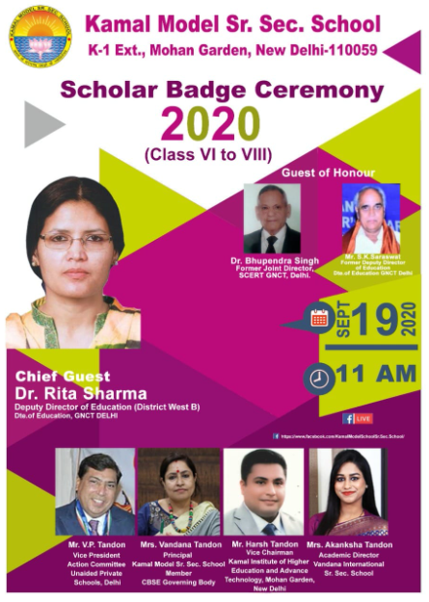
SCHOLAR BADGE CEREMONY
“Winners are not the people who never fail, but the people who never quit”.
Kamal Model School in its extreme glory and grandeur held its first Virtual Scholar Badge Ceremony for classes VI-VIII on 19 September 2020. The Chief Guest of the occasion was Dr. Rita Sharma, Deputy Director of Education, District West B. Dr. Bhupendra Singh, former Joint Director of SCERT, Delhi and Mr. S. K. Saraswat, former Deputy Director of Education were the Guests of Honour.
The program commenced with the ceremonial presentation of the Ganesh Stuti. The school Principal Mrs Vandana Tandon gave a warm welcome to the distinguished guests. The main events of the program were KMS Stepping Ahead, Memories of the year 2019 and a skit on the Google CEO Sundar Pichai. Each of the scholars of the session 2019-2020 were given befitting titles according to their characteristic qualities. The most ennobling part of the program was when the proud parents felicitated their wards with trophies. The Chief Guest, Dr. Rita Sharma also gave an inspirational speech, motivating the students to carry on working hard and keep on attaining heights of success in future. The program ended on a very positive and promising note with a vote of thanks, presented by our school students.

Slide 7
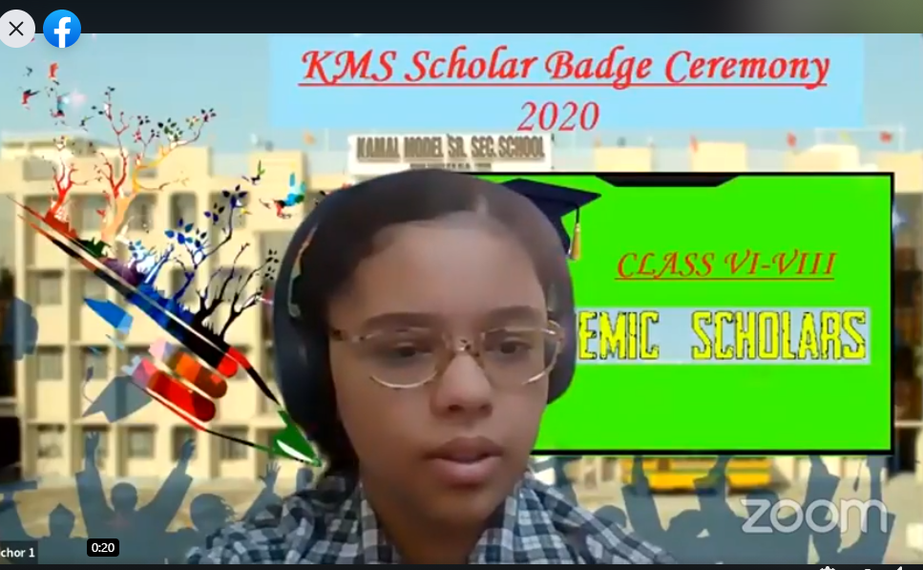
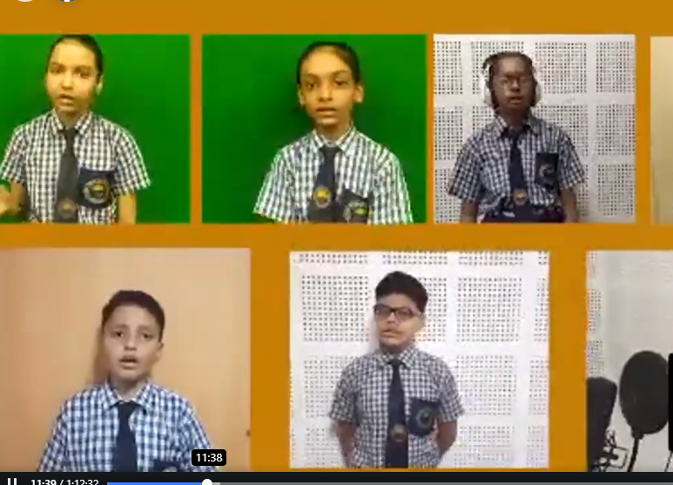
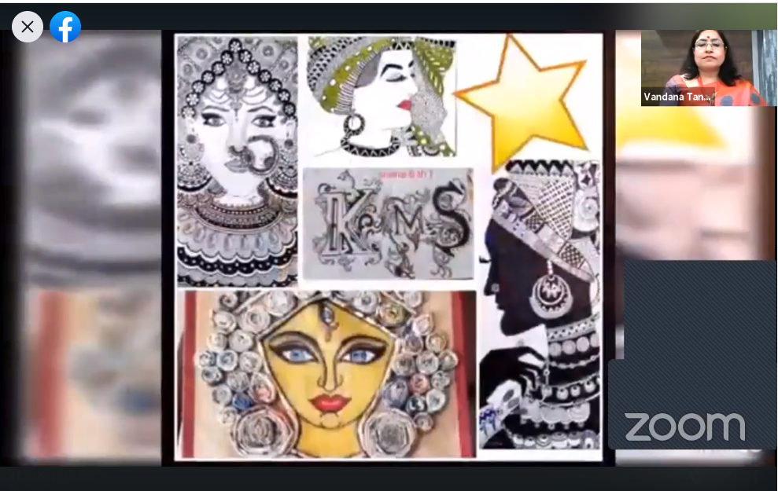
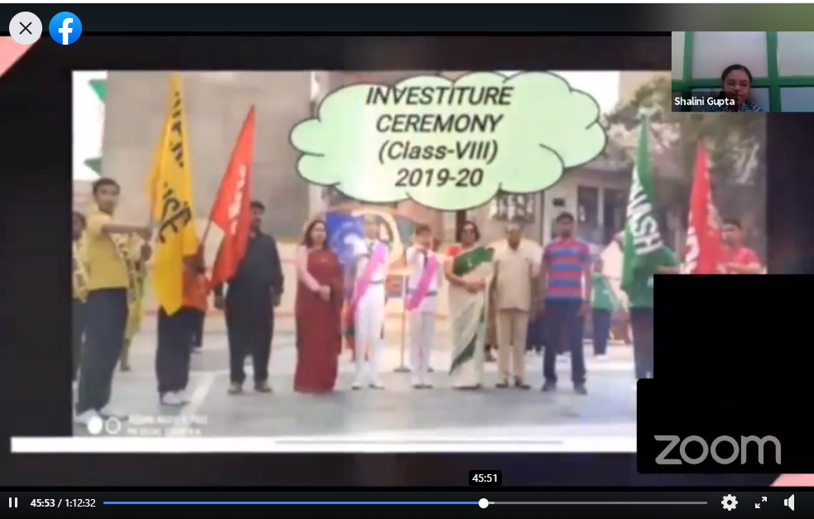
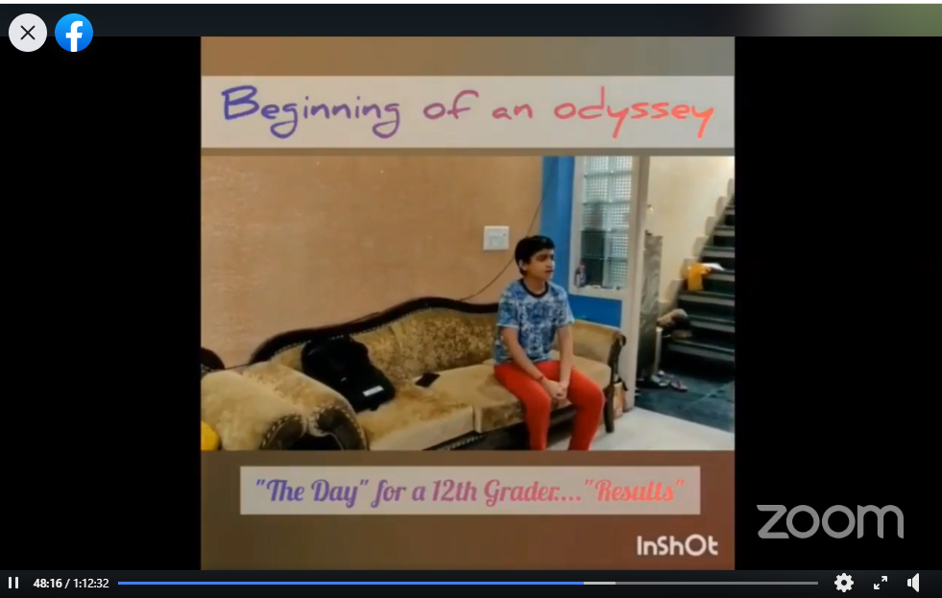
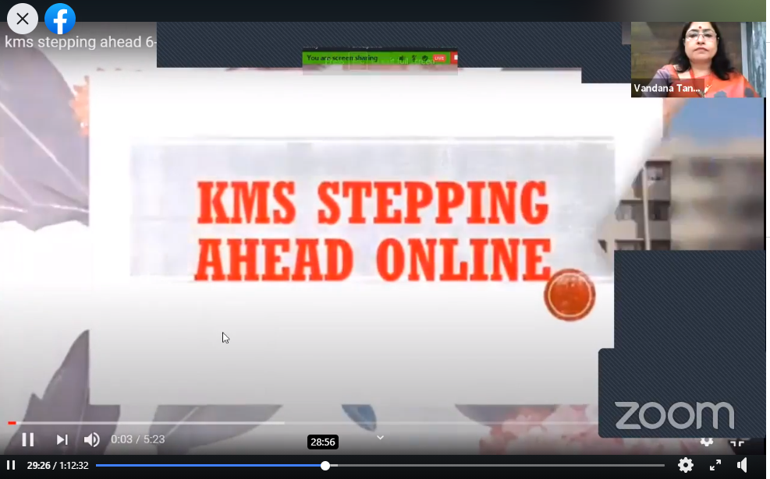
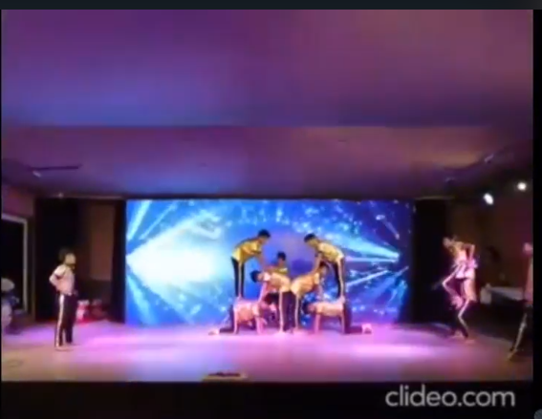
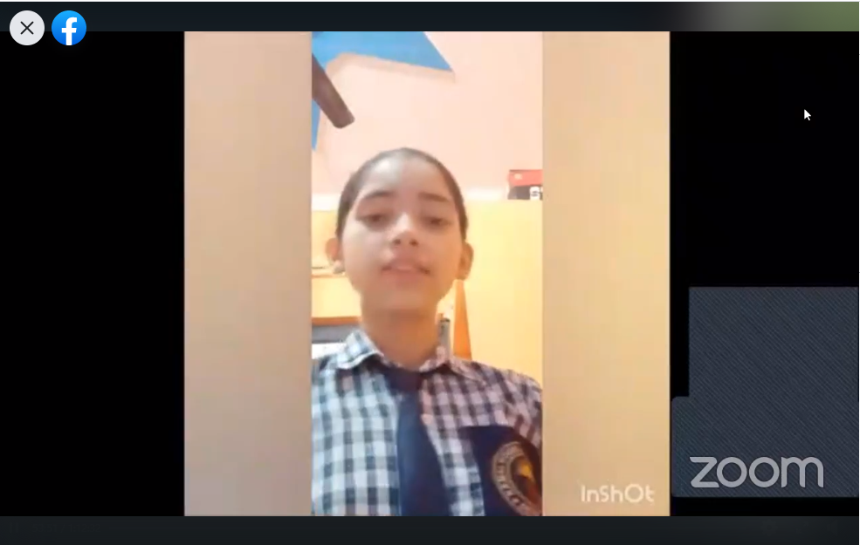
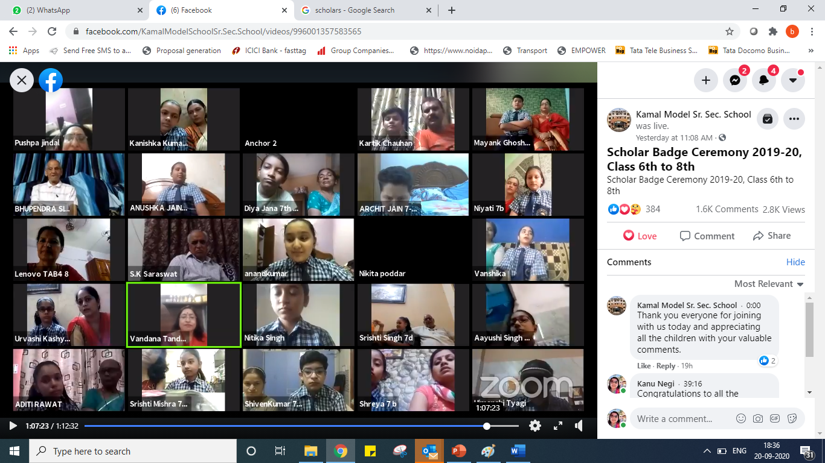
Ceremony Begins

Slide 8
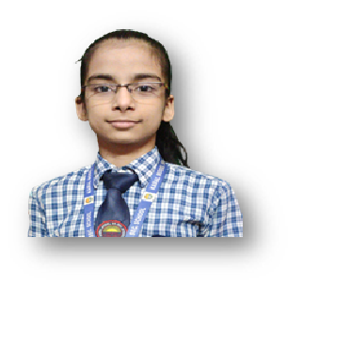
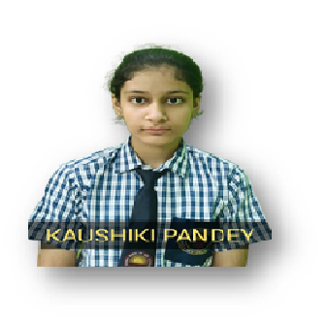
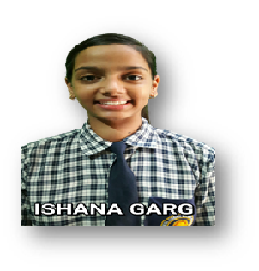
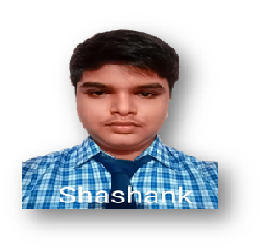
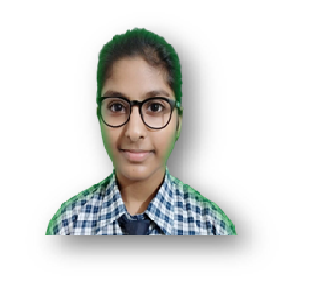
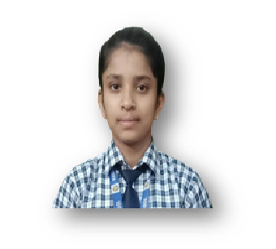
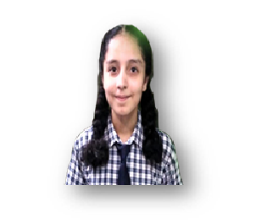
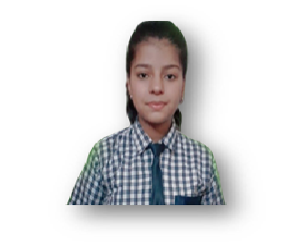
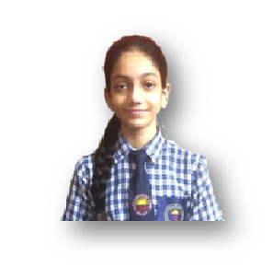
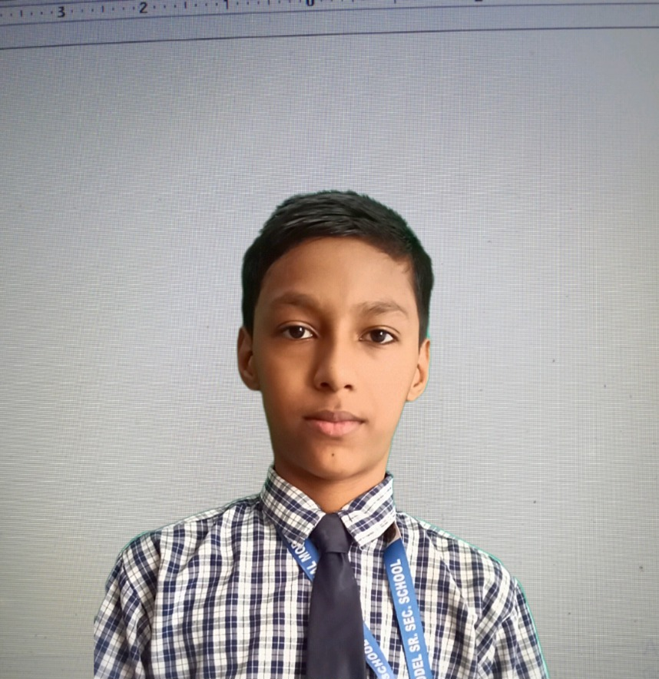
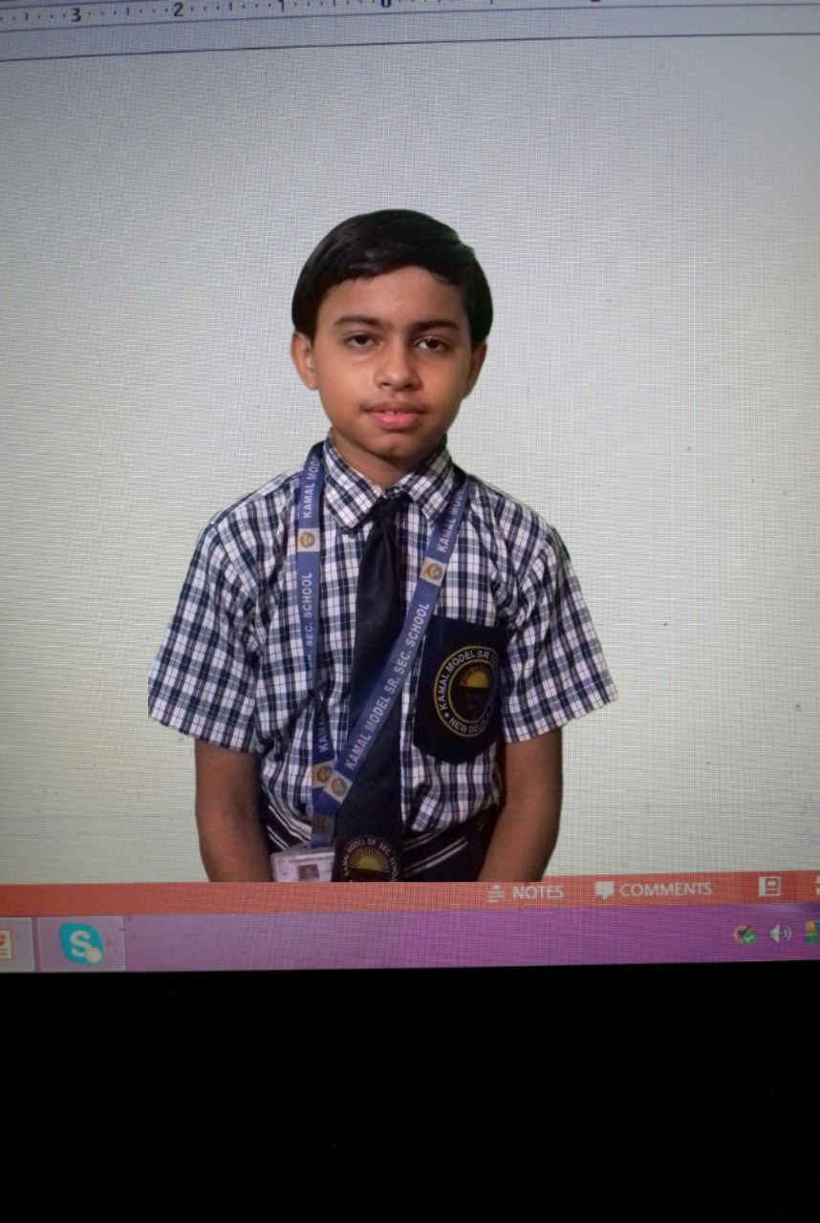
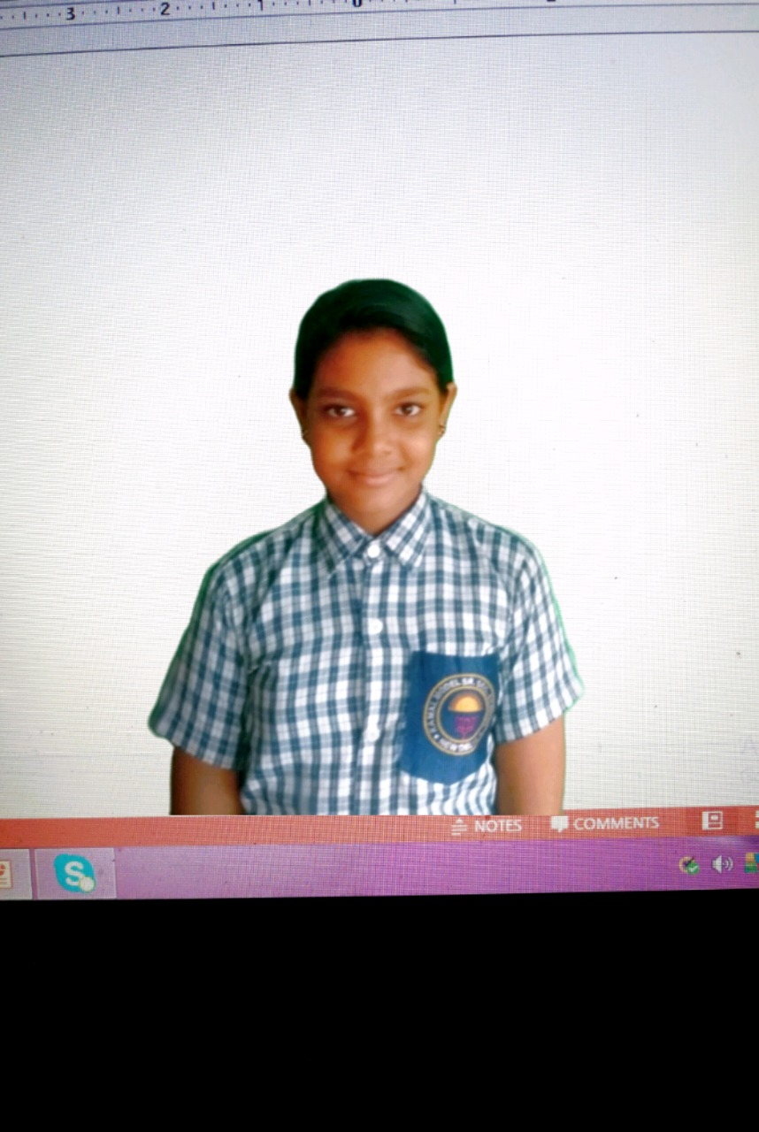
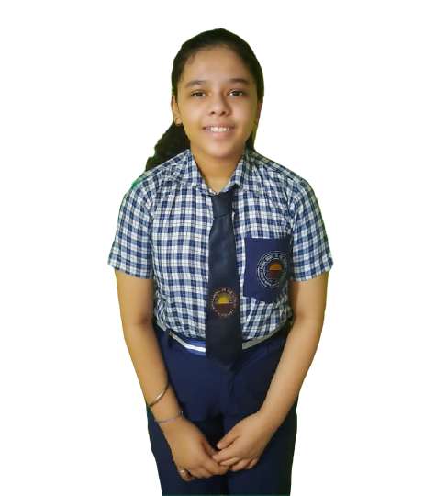
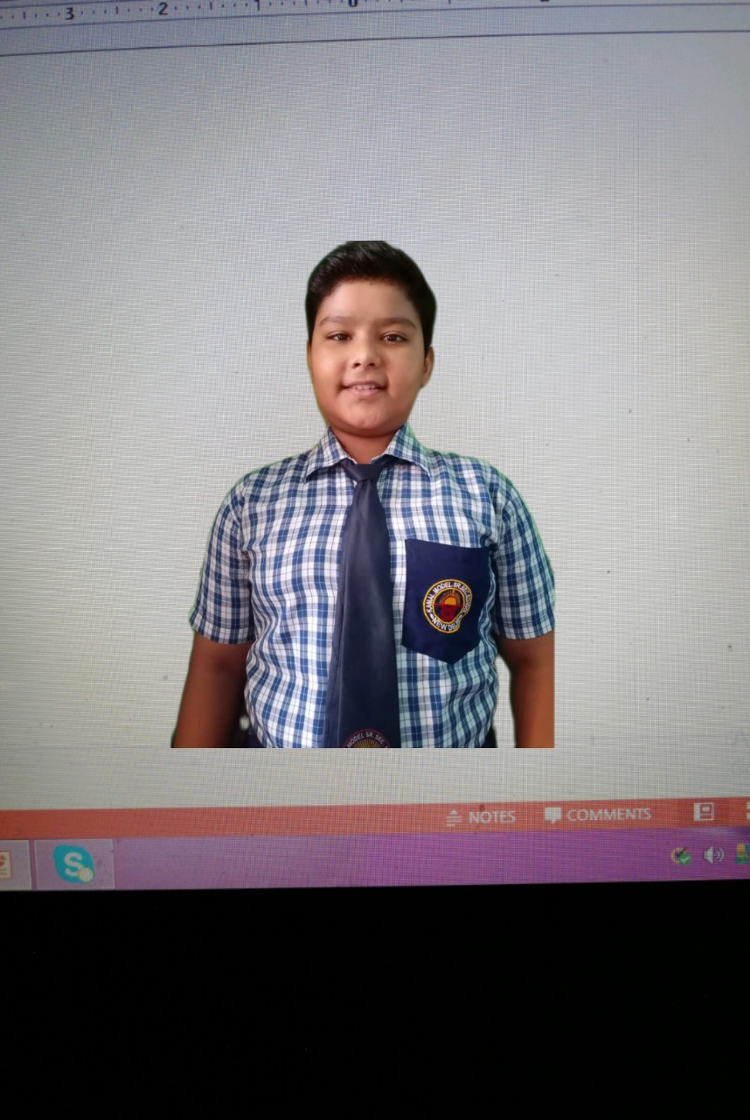
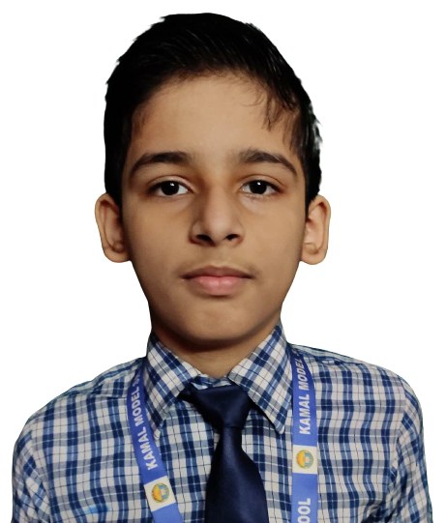
Our Top Scholars
Class 8th
Class 7th
Class 6th

Slide 9
Scholars Messages
Exam Preparation: Study Tips:
1) Snack on brain food. ...
2) Give yourself enough time to study
3)Organize your study space and time
4) Practice on old exams. ...
5)Explain your answers to others. ....
Sukanya
1) I firstly start by reading and understanding the chapters so that the concept will be clear to me. 2) And from that I frame some questions by myself and write the answers. 3) and I also explain the chapter to myself only. 4) understand those questions which are important.5) and I always begin with the chapters that are big or have many topics to be covered. This is how I prepare for exams.
Kaushiki
Annupriya
Thankyou Kamal model school and all my respected teachers to make me a scholar student.today the achievement that I achieve only because of your hardwork and inspiration.you have worked so hard in shaping me into the student that I am today.you are are an inspiration to students and other teachers alike.you have activated a hunger for knowledge and wisdom, inspiring me to plan my future and become a better individual.even now when schools are closed and most of the countries in quarantine due to coronavirus pandemic,in that time also you are continually studying e inspiring us to make a bright future for us. And all the students should respect and thanks their teachers and school for doing such an hardwork and to make a bright future for us. Thankyou!! By Annupriya
Sanyaa
I am really glad that i became a scholar this year as it was joyous moment for me and for my family because I was quite of an average student. I am really thankful to my friends and family who motivated me and told me to believe in myself and 'hard work does pay off' thank you
As a scholar , I would like to share my personal views on education with all . First of all I would like to say that the studies shouldn't be a pressure , but rather it should be fun for us all .If we start learning from our childhood making a strong base helps us , whole life . Daily learning and practicing are the primary goal to be a scholar. Marks don't really matter for me but the mistakes and knowledge do.
Priyanshi
Chetna
I am nothing in my self but these all are the efforts of my teachers and parents who helped me in securing this position.

Slide 10
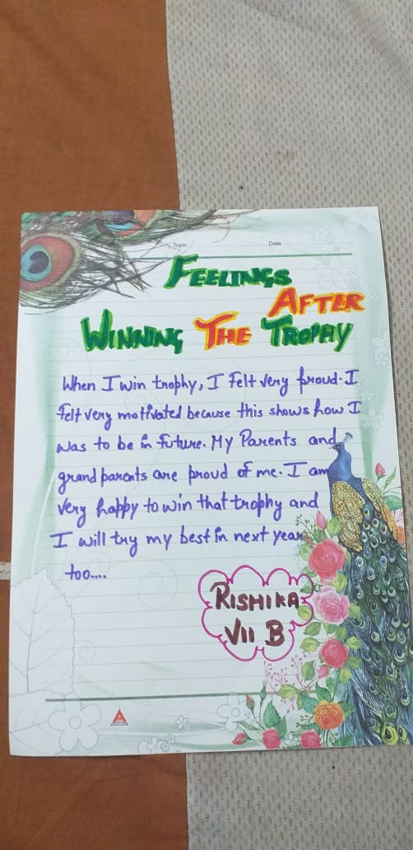
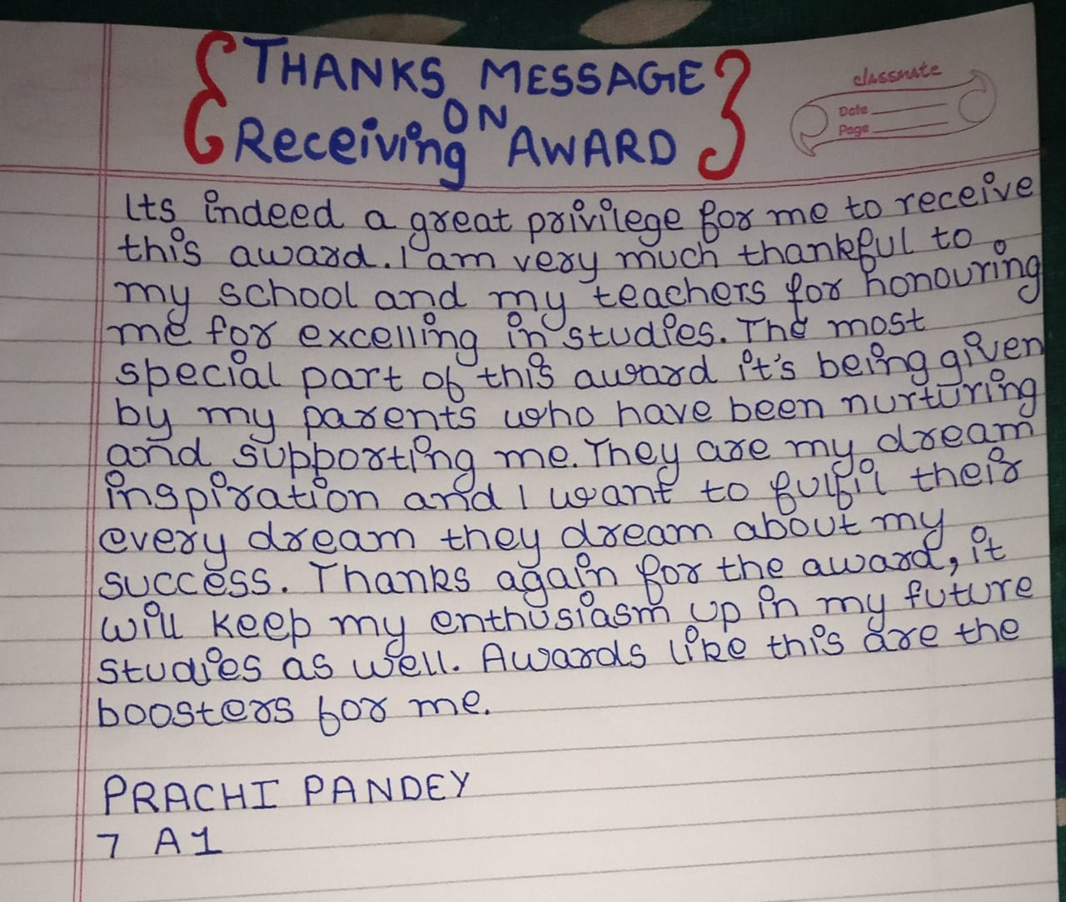
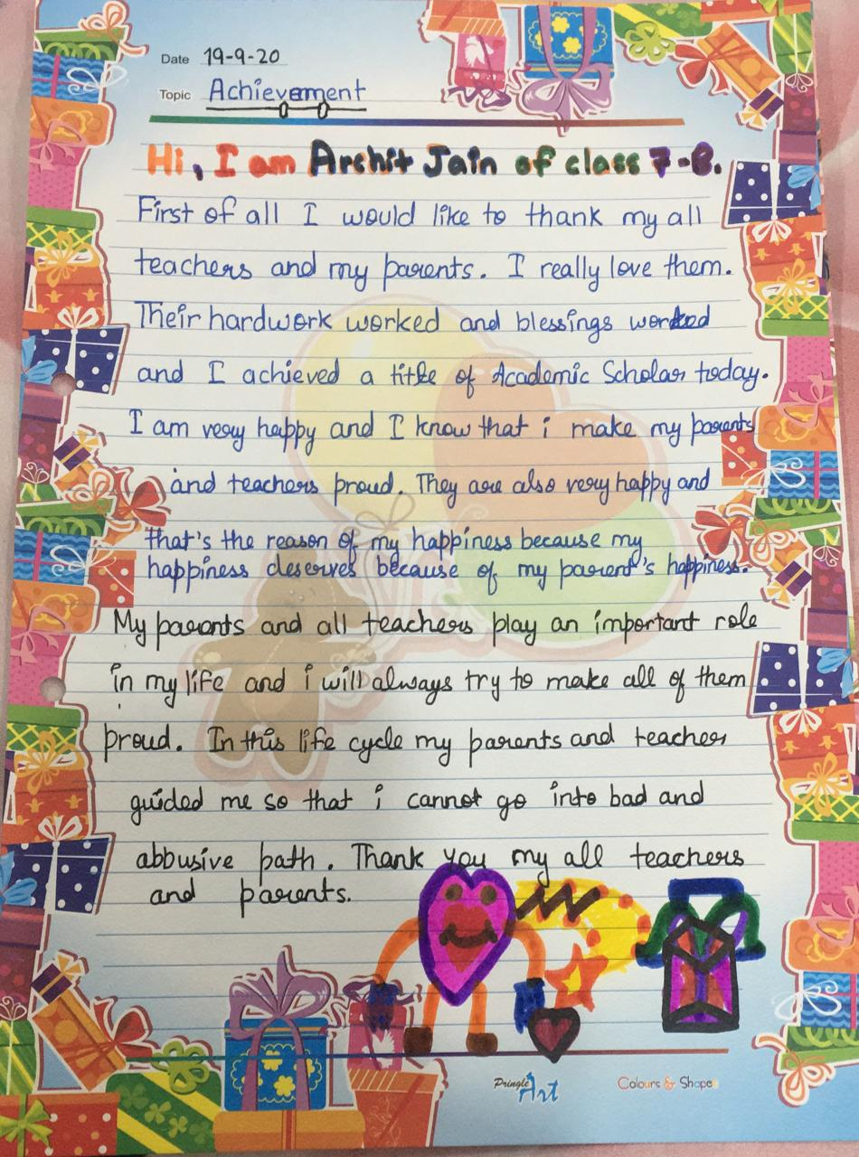
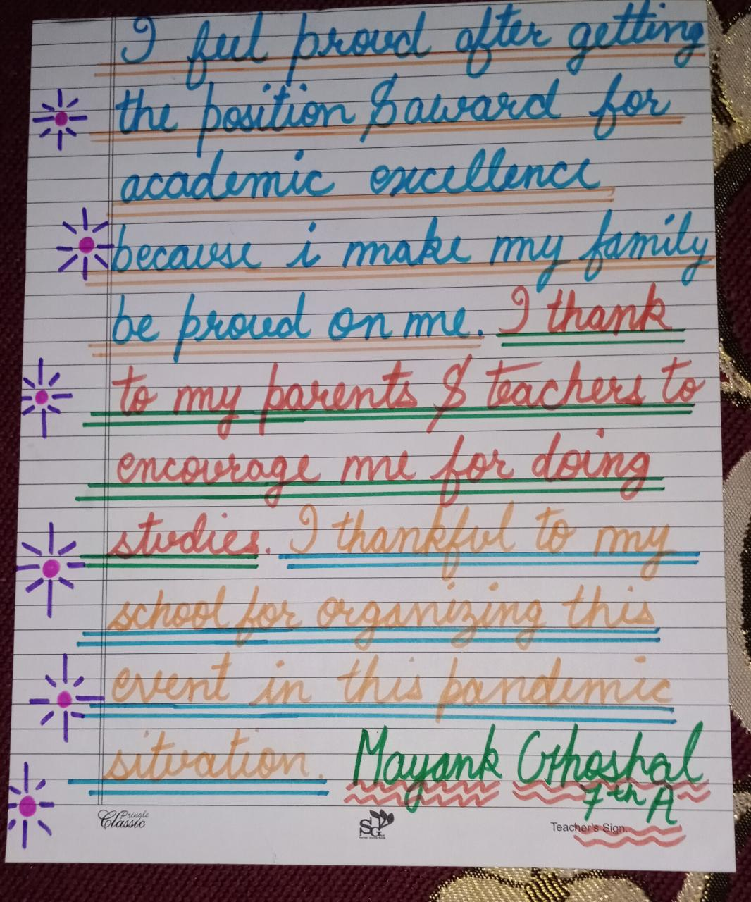
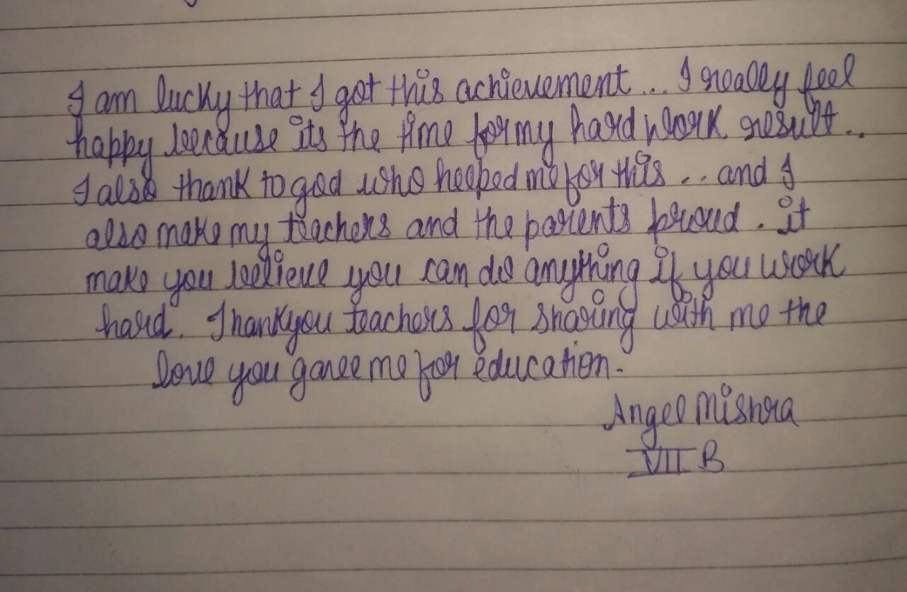

Slide 11
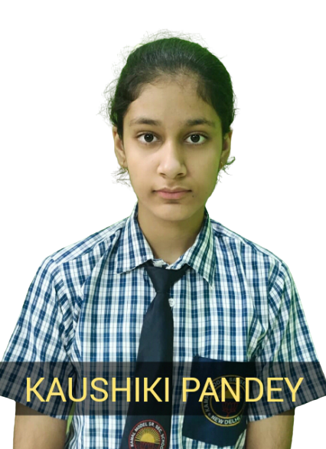
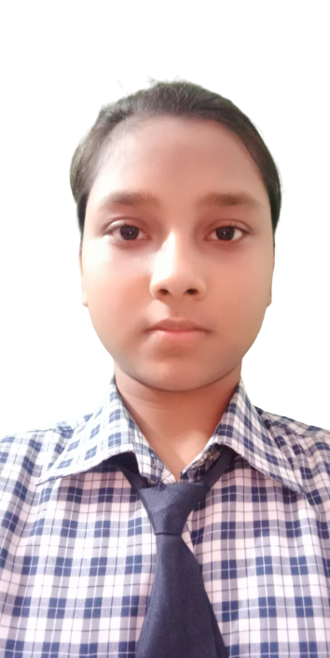
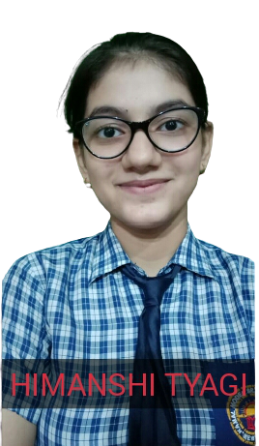
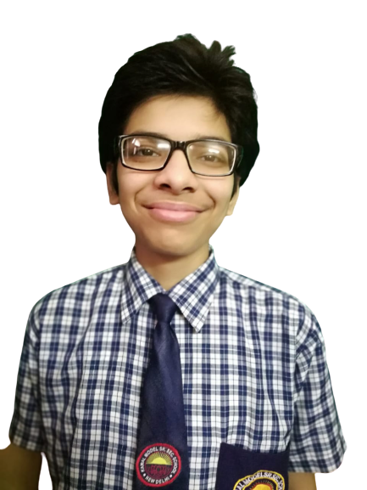
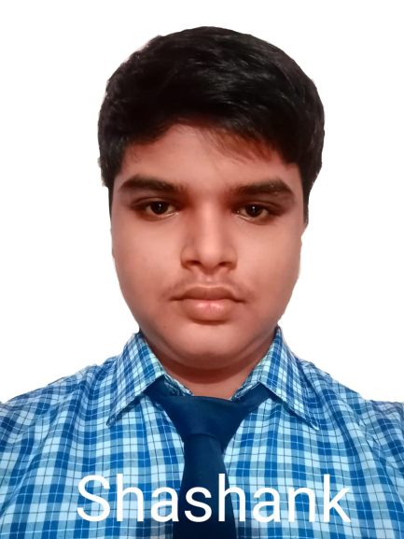
100% Attendance Students
100% Attendance for last four years
I am able to have the 100% attendance for 4 years because of my parents. Special credit is to my mother. She is the one who take care and always keep me healthy. And father always woke me up in the morning for school. Due to which I am able to come school regularly. And the second reason is that I enjoy going to school due to which I never take any leave. These are the only reasons for being 100% attendee. I would like to give message to other students that coming to school regularly make more chances of getting the concept clearly.
100% Attendance for the year 2019-2020

Slide 12
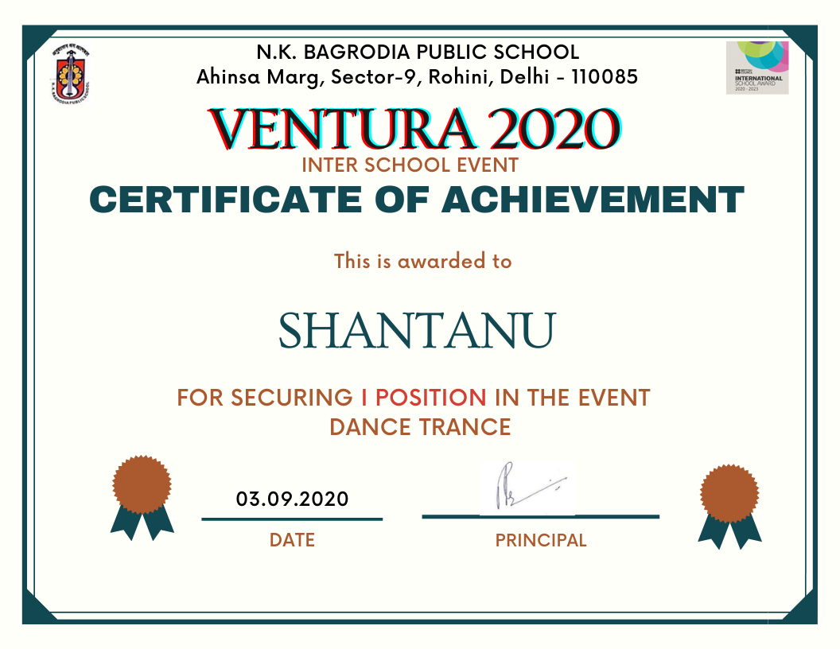
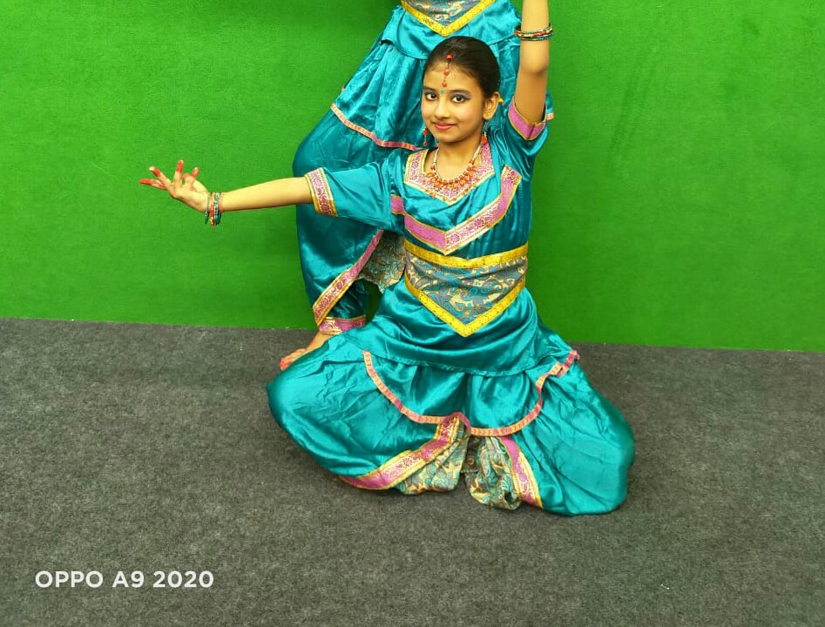
अद्भुत प्रतिभाएं
‘ मैंने जाना है पैरों से भी उड़ना ‘
यह बात शांतनु के लिए शत प्रतिशत चरितार्थ होती है।शांतनु कक्षा 8 में पढ़ते हैं। नृत्य के विभिन्न शैलियों पर पूरी क्षमता रखते हैं। जिस भी प्रतियोगिता में उतरते हैं, अपनी अनोखी पहचान कायम रखते हैं ।वाद्य यंत्रों का भी शौक रखते हैं ।ईश्वर इन्हें हर क्षेत्र में सफलता दें ।
‘मेरी आंखों में सपने हैं , सपनों में थिरकता पंछी ‘
सातवीं कक्षा की सृष्टि मिश्रा के पैर मंच पर पड़ते ही आत्मविश्वास से चमक उठते हैं।नृत्य के साथ सृष्टि कला और गणित में भी विशेष रुचि रखती हैं ।उसके माता पिता भी उसकी दिलचस्पी और भविष्य का पूरा ख्याल रखते हैं। मम्मी प्रियंका मिश्रा जो स्वयं एक शिक्षिका हैं उनका कहना है कि बच्चो का कौशल विकास अत्यंत आवश्यक है।

Slide 13
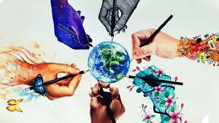
अद्भुत प्रतिभाएं
पारस वर्मा
‘देखन में छोटे लगे घाव करत गंभीर’
बहुमुखी प्रतिभा के धनी पारस पढ़ाई, चित्रकला ,नृत्य, संगीत के साथ साथ अभिनय पर भी मजबूत पकड़ रखते हैं ।एकल अभिनय में कई पुरस्कार जीत कर विद्यालय और माता पिता का गौरव बढ़ा चुके हैं । इनके माता पिता , और बड़ी बहनों का पूरा पूरा समर्थन रहता है। हम इनके उज्जवल भविष्य की शुभकामना देते हैं।
अनन्या अरोड़ा
मेधावी विद्यार्थी अनन्या अरोड़ा की शैक्षिक योग्यता तारीफे काबिल है।परंतु नन्ही अनन्या आज्ञाकारी, मितभाषी और अनुशासनप्रिय होने के साथ एक कुशल नृत्यांगना हैं ।मंच पर पड़ते उनके पैर अपनी भावभंगिमा के साथ दैवीय संगीत प्रस्तुत करते हैं।इस सफलता में वे अपनी मां की भूमिका बताती हैं।ईश्वर उन्हें एक नई ऊंचाई दें ।
आकांक्षा
पंखों की परवाज़ और ही है।उड़ने दो परिंदों को एक नया आसमान और भी है।
आकांक्षा कक्षा 6 की नन्ही विद्यार्थी अभिनय में दिनों दिन निखार ला रही हैं ।उम्र महज़ 11वर्ष ओर प्रतिभा ऐसी की बड़े बड़े कलाकार भी वाह वाह करते नहीं थकते। इनकी अभिनय प्रतिभा के पीछे मां और बड़ी बहनों का प्यार,दुलार है।सुनहरे भविष्य के लिए ढेर सारी शुभकामनाएं।

Slide 14
ACHIEVEMENTS

Slide 16
STUDENTS ARTICLES
शिक्षक हमारे पहले देवता हैं क्योंकि वे हमें उन चीजों को करने की हमारी क्षमता का एहसास कराते हैं जिनकी हम कभी कल्पना नहीं करते हैं। वे हमारे जीवन के हर कठिन से कठिन समय में हमारा मार्गदर्शन करते हैं।वे हमारे भविष्य को आकार देते हैं और हमें बुद्धिमान और आदर्श नागरिक बनाते हैं। वे हमें अपने सपनों को आगे बढ़ाने के लिए प्रेरित करते हैं और हमारे व्यक्तित्व को बेहतर भी बनाते हैं। हमें अपनी क्षमता के बारे में बताने के लिए हमें अच्छा इंसान बनाने के लिए अपने शिक्षकों के प्रति कृतज्ञता महसूस करनी चाहिए। उनके प्रति कृतज्ञता को बताने के लिए हम प्रतिवर्ष शिक्षक दिवस मनाते है।
धन्यवाद और शिक्षक दिवस की बहुत बहुत शुभकामनाएं ।
निहारिका
IMPORTANCE OF SPORTS
Sports is such an activity that it can be taken up by anyone ; at any age and any point of life. Adults, children and elders – everyone alike take part in sports. Many regard sports as a co-curricular and extra circular activity in schools. However, sports play an equally important role as education in person’s life. To achieve overall and all-round development in life, one should be well-versed in both sports and culture. While training sharpens the mind , sports sharpens the body and makes it fit. Thus, both are essential.
There are numerous advantages of involving oneself in sports. First and foremost, as known by all and very definitively, competitions increase the physical fitness of an individual. Additionally, sports also contribute to building stable mental well- being of a person Various researches show that people who are in the daily practice of sports in any form record better mental as well as physical health. Moreover, sports also eliminates the risk of a person catching diseases or facing any bodily interruptions. Competitions increase immunity and increase people’s stamina.
By Meghna Negi
मै नारी हूं।
मुझे नारी होने का गौरव मिला, सम्मान भी मिला।लेकिन समाज में स्थान नहीं मिला ।क्यो ?क्या मै सिर्फ सजावट की बस्तु भर हूं।बड़े बड़े पुराणों में आदि काल से पढ़ते आए रहे हैं,सुनते आ रहे है यत्र नार्यस्तु पूज्यंते रमंते तत्र देवता"।सच्चाई से कोसों दूरक्योंकि इन सिद्धांतो में शक्ति और सच्चाई होती तो निर्भया, दामिनी और मनीषा बलात्कारियों की बली नहीं चढ़ी होती।दुष्कर प्रश्न है ऐसी घटनाएं क्यो लगातार हो रही है? हमारी बेटियां कमजोर है या बेटे दुर्योधन।आश्चर्य है जब बेटी को संस्कार का पाठ पढ़ाते है तो बेटे को बाहुबली बनाने में क्यो जुट जाते हैं? सवाल का जवाब स्वयं में ढूंढें।उत्तर मिल सकता है।आप ,आपका परिवार आपका बेटा, आपका भाई और आपके पति मिलकर लड़कियों का मान करें,ओर इस दुर्घटना को पनपने दें ।
जय हिन्द जय भारत।

Slide 17
STUDENTS ARTICLES
WOMEN - THE POWER OF SOCIETY
The existence of human life on the earth is impossible without the equal participation of both women and men. They are equally responsible for the survival of the human race on the earth. They are also liable for the development and growth of a nation. However, the existence of the woman is far more important than men. Because without her we cannot think about our existence. It’s a common practice in India where people abort or kill girl child on birth. But, they should be saved, given equal opportunity, and respect and opportunity to go ahead in life. Apart from that, the fate of civilization lies in their hand as they are the root of our creation. There are various evil practices in our society; one of which happens to be the desire to have a boy. In Indian society, everyone wants an ideal mother, sister, wife, and daughter. But they never want that girl to be his blood relative. Besides, there are other social evils in society that forces many parents to avoid having a girl child. These other social evils are dowry deaths, female feticide, and some others. Although girls are ahead of boys in many fields but still people prefer a boy child. Girls have proven themselves better in every field than boys. And due to their hard work and dedication, they have been to space also. They are more talented, obedient, hardworking, and responsible for the family and their life. Besides, girls are more caring and loving towards their parents. Above all, they give 100% in every work. The crime against women is a big barrier to the development and growth of the country. However, the government takes this problem seriously and for stopping female feticide they have banned the sex determination, and scan tests in the hospitals and labs. The government takes all these steps to create awareness in society that girls are a gift of God and not a burden. A girl child deserves a life where she is treated equal to a boy. And she should be loved and respected like others. She participates in the development and growth of the nation equally. Besides, she works hard for the betterment of society and country. They have also proven their worth and stand equal to boys in every field. Hence, they deserve to survive as their survival means the existence of the human race.
Name - Siddharth Sakrit

Slide 18
Celebrations of the Month
5Sep->Teacher’s Day
8 Sep- International
Literacy Day
14Sep-> Hindi Diwas
15Sep-> Engineer’s Day
16Sep- World Ozone Day
23Sep-International Day
of Sign Language
27Sep-World Tourism Day
29Sep-World Heart Day

Slide 20
CELEBRATION OF READING WEEK
“Reading maketh a full man; conference a ready man; and writing an exact man.”--Francis Bacon
Recognising the importance of reading and to mark the occasion of International Literacy Day, CBSE announced the celebration of Reading Week from 8th September to 14th September. In keeping with this, various activities were conducted to promote reading habits among the students. The students of 8th standard were encouraged to read short stories written by the famous author Ruskin Bond. Students explored the various stories, read them and also penned the character sketch of the characters they liked the most. Besides this, the students even gathered additional information on Ruskin Bond - the famous novelist and children’s short story writer.

Slide 21
विश्व हिन्दी दिवस
आज हिंदी दिवस के उपलक्ष्य में कमल मॉडल सीनियर सेकेंडरी स्कूल की अध्यापिकाओ और छात्रों द्वारा एक यादगार आयोजन ज़ूम ऐप के माध्यम से किया गया । इस भव्य कार्यक्रम में अतिथिगण प्रसिद्ध फिल्म निर्माता-निर्देशक अनिल शर्मा और रोहित चौधरी रहे। श्रीमती वंदना टंडन जी ने दीप प्रज्वलित करके उनका स्वागत किया।कार्यक्रम की शुरुआत सरस्वती वंदना से की गई। बच्चों ने इस कार्यक्रम में बहुत सुंदर स्लोगन और कविताओं के माध्यम से भारत के एक एक बच्चे को हिंदी भाषा का दूत बनने के लिए प्रेरित किया । कार्यक्रम के बीच में अतिथि गणों ने अपनी ज्ञान पूर्ण बातों से भारतीयों को अपनी हिंदी भाषा के प्रति ईमानदारी, उनके प्रचार- प्रसार पर बल देते हुए कहा कि वर्तमान पीढ़ी अपने कार्यों द्वारा अपनी मातृभाषा और राष्ट्र को पूरे विश्व में सम्मानित करेगी । अंत में प्रधानाचार्य ने बच्चों का उत्साहवर्धन किया। कार्यक्रम में आए अतिथि गणों का धन्यवाद किया गया।इस कार्यक्रम की महत्वपूर्ण कड़ी श्रीमती संजू मिश्रा और उनकी सहायक अध्यापिकाओ ने सभी का धन्यवाद प्रकट करते हुए यह कामना की कि अब वह दिन दूर नहीं जब हिंदी राष्ट्रभाषा के गौरव से सम्मानित होगी ।इस कार्यक्रम से जुड़े सभी सदस्यों को हिंदी दिवस की ढेरों बधाइयां ।

Slide 22
विश्व हिन्दी दिवस

Slide 23
अभियन्ता दिवस
अभियंता दिवस विशेष
15 सितम्बरब्रिटेन में एक ट्रेन तेज गति से गाड़ी जा रही थी ।ट्रेन अंग्रेजों से खचाखच भरी हुई थी ।अंग्रेजों से भरे उस डिब्बे में एक भारतीय भी बैठा हुआ था ,वह शांत गंभीर भाव से बैठा था ,मानो किसी उधेड़बुन में लगा हुआ हो ।उस डिब्बे में भारतीय का बैठना अंग्रेजों को खटक रहा था।उनका पूरा समूह उस भारतीय का उपहास और अपमान ट्रेन की गति से ही किए जा रहे था।तभी एकाएक वह शख्स सीट से उठा और जोर से चिल्लाया,"ट्रेन रोको “!कोई कुछ समझ पाता ,इसके पूर्व ही उसने ट्रेन की जंजीर खींच दी। ट्रेन रुक गई, अब तो जैसे अंग्रेजों का गुस्सा फूट पड़ा सभी उसको गालियां दे रहे थे ।जाहिर है जितने भी शब्द उनके शब्दकोश में थे , वे भारतीय पर बौछार कर रहे थे ।किंतु वह शख्स गंभीर मुद्रा में शांत खड़ा था, मानो किसी भी बात का उस पर कोई असर नहीं हो रहा है ।उसकी चुप्पी अंग्रेजों का गुस्सा और बढ़ा रही थी ट्रेन का गार्ड दौड़ा दौड़ा आया और ऊंची आवाज में पूछा, जंजीर किसने खींची? कोई अंग्रेज बोलता उसके पहले ही गार्ड बोल उठा ;'पागल हो क्या 'पहली बार ट्रेन में बैठे हो ?तुम्हें पता है ना बिना कारण रोकना अपराध है गार्ड गुस्से में बोला । भारतीय ने शालीनता से कहा नहीं रोकता तो सैकड़ों लोगों की जान चली जाती ।उसकी बात सुनकर सब जोर जोर से हंसने लगे ।किंतु उसके बिना विचलित हुए पूरे आत्मविश्वास के साथ कहा यहां से करीब एक फर्लांग की दूरी पर पटरी टूटी हुई है, आप चाहे तो चल कर देख सकते हैं। कुछ तो रास्ते में भी उस हिंदुस्तानी को गाली देने में कोई कसर नहीं छोड़ रहे थे ।सबकी आंखें फटी की फटी रह गईं, जब वाकई बताई दूरी के आसपास पटरी टूटी हुई थी । नट बोल्ट खुले हुए थे ।भारतीय को पागल कह रहे थे। वे सभी उसे कौतूहल वर्ष देखने लगे ,मानो पूछ रहे हो यह सब उसे कैसे पता चला ?गार्ड ने पूछा तुम्हें कैसे पता चल गया कि पटरी टूटी हुई है ?उसने कहा श्रीमान सब लोग ट्रेन में अपने अपने कार्य में व्यस्त थे। उस वक्त मेरा ध्यान ट्रेन की गति पर केंद्रित था ,ट्रेन स्वाभाविक गति से चल रही थी किंतु अचानक पटरी के कंपन से उसकी गति में परिवर्तन महसूस हुआ। ऐसा तब होता है जब कुछ दूरी पर पटरी टूटी हुई हो ।तब मैंने बिना समय गवाएं ट्रेन रोकने हेतु जंजीर खींच दी। गार्ड और वहां खड़े अंग्रेज दंग रह गए ।गार्ड ने पूछा इतना बारीक तकनीकि ज्ञान अवश्य! आप कोई साधारण व्यक्ति नहीं है ।अपना परिचय दीजिए। शख्स ने बड़ी शालीनता से जवाब दिया 'श्रीमान मैं इंजीनियर मोक्षगुंडम विश्वेश्वरैया हूं। सभी इंजीनियर को हार्दिक शुभकामनाएं।

Slide 24
ENGINEER’S DAY

Slide 25
Celebration of World OZONE Day
Ozone Day September 16 was designated by the United Nations General Assembly as the International Day for the Preservation of the Ozone Layer. This designation had been made on December 19, 2000, in commemoration of the date, in 1987, on which nations signed the Montreal Protocol on Substances that Deplete the Ozone Layer activity. Ozone Day was celebrated with the poster making activity. They all explained the importance of ozone i.e how it protects us from the harmful ultraviolet ray's of sun . Students became true environmentalist while describing the ill effects of ultraviolet rays.

Slide 26
OZONE DAY

Slide 27
WORLD GRATITUDE DAY
Gratitude means thanks and appreciation. Gratitude comes from the Latin word ‘gratus’ which means ‘thankful or pleasing’. When you feel gratified , you are pleased with what someone did for you and you are also pleased by the results.
Our students celebrated the World Gratitude Day by expressing their views on how they showed their gratitude for all that they possess and also to those people around who are always doing something or the other for them. A simple ‘Thank You’ note, a smile, spending a few minutes talking to them, were suggested as some ways to show gratitude to others.

Slide 28
International day Of Sign Language
International Day of Sign Languages is celebrated annually across the world on 23 September every year along with International Week of the Deaf. The choice of 23 September is the same date that the World Federation of the Deaf was established in 1951. According to the World Federation of the Deaf, there are around 72 million deaf people across the world. Put together, they use around 300 different sign languages. This day recognizes the importance of sign language in the growth and development of the deaf and seeks to preserve it for the benefit of the deaf community.
A
K
U

Slide 29
WORLD TOURISM DAY
We all know that travel makes one happy and modest. In this month of September, students learnt the importance of travelling and tourism that made all of us aware about the tiny place we all belong to as said by Mr. Gustave Flaubert. Students made posters and shared slogans to celebrate this day virtually. Also some made their own videos where they were enjoying their travelling to different places. A few of them made their own vlogs at home that gave them a feel of roaming to different places.

Slide 30
Celebration of World Heart Day
Students celebrated World Heart Day to create an awareness towards the students and people of our society. Students also created an amazing poster which showed how the Heart is diamond of our body. World heart Day takes place on 29th September every year and is the World Heart Federation‘s and the world’s biggest platform for raising awareness about cardiovascular disease, including heart diseases and stroke. This year, our campaign focused on creating a global community of Heart Heroes … people from all walks of life who are acting now to live longer, better, healther lives by making a promise.

Slide 31
International Day of Democracy
International Day of Democracy is observed every year on 15 September. This day is celebrated with the purpose of upholding and promoting the principles of democracy. The values of freedom, respect for human rights and the principle of holding periodic and genuine elections by universal suffrage are essential elements
of democracy. Students were made aware
of such rights and principles as they themselves are living in a democratic country, India. To celebrate this day virtually, students of class 6th made beautiful posters to promote the aspirations of all people to strive for the realization of shared universal values. They also shared their views as to how they observe and be a part of democracy in their country.
International Day of Peace
International Day of Peace or World Peace Day is observed annually on 21 September. Peace is the very important need of today’s world as various issues are existing in the present scenario which can disrupt world peace in many ways. KMS students of class 6th celebrated World Peace Day virtually by giving beautiful messages to avoid conflicts and maintain peace and harmony around the world. For this they made amazing posters with a hope to spread this message even in this pandemic situation.

Slide 32
Subject Activities
MATHS
HINDI
FRENCH
SANSKRIT
ENGLISH
SOCIAL SCIENCE
SCIENCE
COMPUTER

Slide 33
MATHS
Protractor of life depends upon yourself,
to choose in which angle you should move.
In this activity, students were given to make protractor of their own and they took part in it very enthusiastically.
By this activity, they got to know about these useful funny facts:
To measure all types of angles.
They got a good idea of positions of degree measures on a protractor.
They know now that why protractors usually have two sets of numbers going in opposite directions.
Sum of two adjacent degree measures given in two different sets of numbers is always equals of 180°.
Students can now give various examples of different kinds of angles from their surroundings rationally.
Introduction To Graph
A Cartesian plane to plot any point in plane was discussed during this fortnight in VIII class in Math. "Graph in packet " this activity was conducted in classes. Cartesian plane, coordinates, abscissa, ordinate, quadrants, scale etc. were the new terms students discovered this fortnight. Quiz based on these term was also conducted. Students showed great enthusiasm in all these activities.

Slide 34
वह कैसी माएं थी
जो गीली लकड़ियों को फूंक कर चूल्हा जलाती थी।
जो सिल पर सुर्ख मिर्चें पीसकर सालन पकाती थी।
सुबह से शाम तक मसरूफ लेकिन मुस्कुराती थी।
भरी दोपहर में सर अपना ढककर मिलने आती थी।
जो पंखे हाथ से झलती थी और बस पान खाती थी ।
जो दरवाजे पर रुक कर देर तक रस्में निभाती थी ।
पलंगों पर नफासत से दरी चादर बिछाती थी ।
बसद इसरार मेहमानों को सिरहाने बिठाती थी ।
अगर गर्मी ज्यादा हो तो रूह अफजा पिलाती थी।
जो अपनी बेटियों को स्वेटर बुनना सिखाती थी ।
जो कलमें काढ कर लकड़ी के फ्रेम में सजाती थी ।
दुआएं फूंक कर बच्चों को बिस्तर पर सुलाती थी ।
अपनी जा- नमाजे मोड़कर तकिया लगाती थी।
कोई साईल जो दस्तक दे उसे खाना खिलाती थी।
पड़ोसन मांग ले कुछ तो बाखुशी देती दिलाती थी।
जो रिश्ते को बरतने के लिए कई गुर सिखाती थी।
मोहल्ले में कोई मर जाए तो आंसू बहाती थी ।
कोई बीमार पड़ जाए तो उसके पास जाती थी ।
कोई त्यौहार पड़ जाए तो खूब मिल जुलकर मनाती थी।
वह क्या दिन थे किसी भी दोस्त के घर हम सो जाते थे ।
तो उसकी मां उसे जो देती वह हमको भी खिलाती थी ।
मोहल्ले में किसी के घर अगर शादी की महफिल हो ।
तो उसके घर के मेहमानों को अपने घर सुलाती थी।
वो कैसी औरते थीं। वे कैसी माएं थी।
मैं जब गांव अपने जाता हूं , फुर्सत के जमानों में ।
उन्हें ही ढूंढता फिरता हूं गलियों और मकानों में।
मगर अपना जमाना साथ लेकर खो गई हैं वो।

Slide 35
FRENCH
Students of class 6th performed an activity on numbers. They prepared a bingo game and played the game by translating each word in French.
Students of class 7th performed an activity on cartoon characters. They chose one of their favourite cartoon characters and described the character by translating it from English to French. Students enjoyed this activity a lot.
Students of class 8th performed an activity on recette. They chose one of their favourite dishes and described its whole recipe by translating it from English to French. In this activity students learnet a lot of new vocabulary.

Slide 36
संस्कृत प्रवत्त्य:
कक्षा ६
कक्षा ७
कक्षा ८

Slide 37
ENGLISH
Film Analysis
The name is self-explanatory and good to grab someone’s interest, especially of students. Nothing is left behind when it comes to student’s cognitive growth. Here as well, we tried not to miss any aspect of their learning. “Films being an important part of modern world should not be limited to the entertainment purpose, they should be critically analyzed” and students were taught to approach films differently and put their analysis in words. Students were asked to choose any educational or motivational film of their choice and analyze it. Students enjoyed the activity a lot as it was for the first time that students were deliberately asked to watch a film as a part of school learning.
Author’s Pie
Literature being an important aspect of student’s life make it more important for a child to know the wholesome information about the prose he or she is reading and about its author. To make this process interesting for kids an activity was planned which provided them with great amount of knowledge in a unique and interesting way. “AUTHOR’S PIE”- This unique activity grabbed student’s attention and made them do it with great enthusiasm. Through this activity, students could recall the three main purposes of the prose by remembering the acronym “PIE- Persuade, Inform, Entertain”.
Let’s go back
Who says that we cannot correct the mistakes that we have made in the past. Well, it’s not exactly like as it seems to be, our pedagogues tried to make their sessions productive and interesting by using different methods of teaching. So, to teach PAST TENSE, they came up with unique idea to let the students find their mistakes in a sentence that are in past tense and paste a corrected slip over it. Through this activity students understood different formations of past tense. So, this is how they rectified the mistakes made in the past tense.
Wait....What did you think??? hahaha!!!

Slide 38
Social science
Embrace the Diversity
“ It is the time that we all see gender as a spectrum instead of two sets of opposing ideals. - Emma Watson
Gender equality is not only a fundamental human right but a necessary foundation for a peaceful, prosperous and sustainable world. But our world faces a persistent gap in access to opportunities and decision-making power for women and men.
In the light of this, activities like Interview or Interaction with parents, Poster making and Slogan writing were organized in grade 7 to make the students acquainted with the issues regarding gender inequality. In these activities' students had a one-on-one conversation with their parents in which both shared their personal experiences or what they observed in their day-to-day life regarding this sensitive issue. The main objective of this was to make students aware that ‘Gender mainstreaming is not an end, but a means to an end.’ Students' efforts were applauded, and they were urged to become citizens and imbibe good values and ethics in their life.
SCIENCE
Activity: SHADOW STORIES "The eye is always caught by light, but shadows have more to say". - Gregory Maguire
Our young minds of class 6th implemented this statement by conducting an interesting activity on shadows in our virtual classroom under the guidance of their mentor Ms. Bharamjeet Kaur. Students explicited their ideas and created innovative shadows of animals, birds and variety of shapes and patterns with their hands to develop some scenes and pictures to create stories.

Slide 39
COMPUTER

Slide 40
TEACHER’S MESSAGES
"The importance of a guru (teacher) is not known to students but to learners."
No-one is oblivion of the celebration of Teachers’ Day on 5th September every year. Embarking the birth of Dr. Sarvapalli Radha Krishnan, this day appreciates and celebrates each and every drop of sweat, dedication, diligence, patience and devotion poured by teachers into the learners i.e. our youth.
As times have changed and owing to "new norms" of pandemic, the teachers of Kamal Model Sr. Sec. School proved that they are also learners as to how swiftly they adjusted. Each teacher is going out of his/her comfort zone in order to impart knowledge of books and life both.
2020 has been one hell of a road for our nation. Despite this bitter fact, the KMS family managed to make space for little celebrations and happiness. One of them is, the celebration ceremony of teachers' day. The only difference was of physical presence but the warmth and merry remained no less than regular events.
SOPHIYA
अस्माकं जीवने गुरुणाम् महत्तवं
य:ज्ञानं यच्छति शास्त्राणि शिक्षयति च स: शिक्षक:।ऋषि: ,आचार्य:,गुरु:, अध्यापक: इति अपि तस्य नामानि।भारतवर्षे प्राचीनकालात् एव शिक्षकाय महत्तवं प्रदत्तम् ।
शिक्षकस्य स्थानं राज्ञ: अपि उच्चतम्।
शिक्षकं विना ज्ञानप्राप्ति: न संभवा । कवय:तम् ईश्वरात् अपि श्रेष्ठ: इति मन्यते।अद्यत्वे राष्ट्रपतिना श्रेष्ठा: शिक्षका: पुरस्कृयन्ते ।
अज्ञान तिमिरान्धस्य ज्ञानाञ्जन शलाकया ।
चक्षुरुन्मीलितं यन तस्मै श्रीगुरुवे नम:।।
मीनाक्षी पोपली (टी.जी.टी. संस्कृत)
"A teacher for all season“
A teacher is like Spring,
Who nurtures new green sprouts,
Encourages and leads them,
Whenever they have doubts.
A teacher is like Summer,
Whose sunny temperament
Makes studying a pleasure,
Preventing discontent.
A teacher is like Fall,
With methods crisp and clear,
Lessons of bright colors
And a happy atmosphere.
A teacher is like Winter,
While it's snowing hard outside,
Keeping students comfortable,
As a warm and helpful guide.
Teacher, you do all these things,
With a pleasant attitude,
We are a teacher for all seasons,
And we have our gratitude!
Nisha
Pooja
Don't Quit
When things go wrong, as they sometimes will
When the road you're trudging seems all uphill,
When the funds are low and the debts are high
And you want to smile, but you have to sigh,
When care is pressing you
down a bit,
REST, if you must,
but don't you quit.

Slide 41
Paramjit Kaur
EDITOR- ENGLISH
Kanchan Prabha
DESIGNER
Sanju Mishra
EDITOR HINDI

